Slide 1
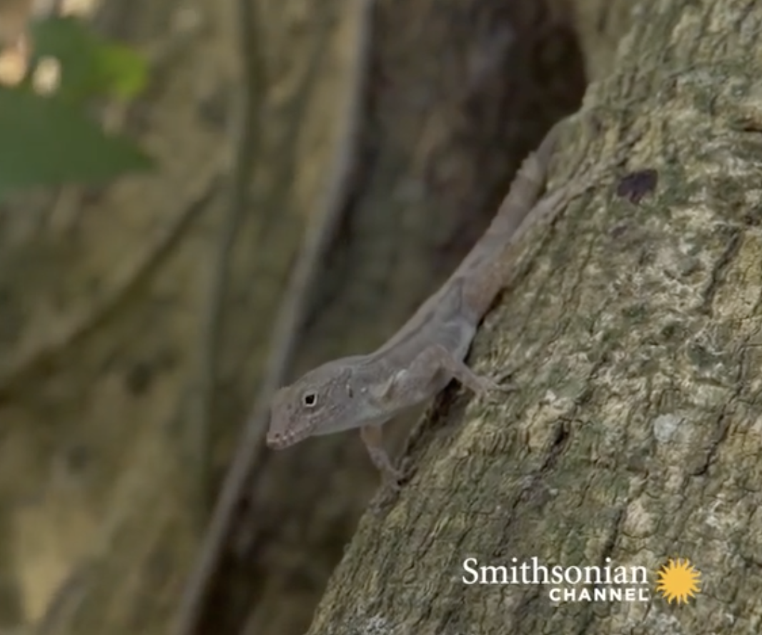
Investigation Question
Evolving Minds
Lesson 7
How Can We Explain
How Anoles Evolved
Bigger Toe Pads?
Notes:
ALL CLASS – SLIDE 1
Remind students that in the last class they used the 6 Key Steps chart to consider evidence from a radish plant investigation.
They explored how natural selection explained the change in hairiness in a radish population whose habitat was invaded by caterpillars that preferred to eat plants with no or few hairs.
Today, they will see a video about a present-day animal population – small lizard s called anoles.
Today’s investigation question is:
How can we explain how anoles evolved bigger toe pads?

Slide 2
Listen to this video for evidence to answer the question
How Can We Explain
How Anoles Evolved
Bigger Toe Pads?
https://youtu.be/52cGcSgQQTo
Notes:
ALL CLASS – SLIDES 2 to 3
Explain to students that they are going to see a video that shows scientists at work studying natural selection in anoles. They will be using evidence from the video to fill out a 6 Key Steps chart to explain the way in which anoles evolved stickier toes, just like with the radishes.
Point to the blank 6 Key Steps chart and ask students to keep the steps in mind as they watch the video.
If students ask what a toepad is, you can tell them that the video will provide a definition.
Show the video.
At the first pause, check for student understanding by asking one or two students to volunteer answers to the following questions:
Do you think there is variation in the toepads of the anoles? (Trait variant: smaller or larger toepads, more or fewer lamellae)
What environmental change did the anoles experience? (Environment changes: city has smooth metal objects such as light poles or hard surfaces and not a lot of rough bark to run up)
At the second pause, ask:
How do the toepads of city anoles differ from the toepads of forest anoles? (Beneficial trait: they have larger toepads, more lamellae and are thus stickier)
Why do you think it is beneficial to be able to run on slippery metal surfaces in the city? (Students can infer: catch flying insects as food, escape predators, find hiding places)
At the end of the video, ask:
Scientists found that city anoles moved faster than forest anoles. What did this tell scientists about their toe pads and lamellae? (Speed told them that city anoles had bigger and therefore stickier toe pads)
If you looked at the anoles in a city population after 10 generations, which toepad size do you think would be more common? (Beneficial trait becomes more common in the population over time)

Slide 3
The Case of the Anoles
6 Key Steps​ | The Story
Variation in traits.​ | Trait = toe pad size Variants = larger - smaller
Environmental change.​
Depending on the environment, certain trait variants are beneficial.​
Individuals with beneficial trait variants are healthier and can have more offspring. ​
This process happens again and again over many generations.​
Over time, populations look different than they used to look.​
What’s the evidence?
Notes:
ALL CLASS – SLIDES 2 to 3
Return to the blank 6 Key Steps chart. Remind students that their task is to use evidence from the video to explain how anoles evolved bigger toe pads. Get started by writing in the first blank box opposite “Variation in Traits”: Trait: Toepad size, variants: larger-smaller.
Next, ask a volunteer for an idea to fill out each subsequent box. Also, ask how they know this. What is the evidence?
Explain that the video may not have provided evidence for all the boxes and so there they will infer what evidence they would look for.
For example: The video doesn’t tell us why having larger toe pads meant anoles were healthier. Why do you think being able to climb slippery surfaces would result in healthier anoles that could have more offspring? For example, how many generations do you think it might take for the anoles to evolve bigger toe pads?

Slide 4
Look at your handout!
Write down why you agree or disagree!
Agree or Disagree!
Notes:
SMALL GROUPS– SLIDE 4
Have students move into their small groups and look at the L7 revised activity handout
Ask students to write their initials on the front of the handout
Tell them that students in another class wrote the 3 explanations for how anole toe pads changed. Students. should discuss all three statements and decide if they agree with them, and why or why not. They should circle whether they agree or disagree then tell Sam, Jeita, and Lee why they agree or disagree
Sam: I think city anoles needed bigger toe pads to climb hard surfaces, so they changed because they needed to (preconception: need)
Jeita: I think city anoles with smaller toe pads had offspring that always had bigger toe pads when they grew up (preconception: development/aging)
Lee: I think city anoles with bigger toe pads could climb higher, so they were healthier and had more offspring with bigger toe pads (correct).

Slide 5
I think city anoles needed bigger toe pads to climb hard surfaces so they changed because they needed to.
Agree or Disagree!
Notes:
ALL CLASS – SLIDE 5-7
One option: Call for student attention and point out that there are two signs at opposite ends of the classroom: Agree and Disagree. Explain that you are going to read out, one at a time, the three statements small groups have been discussing. Each time you read out one of the statements, students should move to the “agree” or “disagree” area of the classroom.
After students have moved to one position or the other (or raised hands), ask one or two student volunteers from the “disagree” side to explain why they disagreed and how their group decided to correct the statement. Follow up with a volunteer or two from the “agree” side. Finally, check with the whole class if they have consensus on the three statements.
Second option: Especially if you are pressed for time, have students stay in their small groups. Students should raise hands if they agree or disagree with each statement and a representative of each group can explain their justification. NB: This option might facilitate more reasoning out loud.

Slide 6
I think city anoles with smaller toe pads had offspring that always had bigger toe pads when they grew up.
Agree or Disagree!
Notes:
ALL CLASS – SLIDE 5-7
One option: Call for student attention and point out that there are two signs at opposite ends of the classroom: Agree and Disagree. Explain that you are going to read out, one at a time, the three statements small groups have been discussing. Each time you read out one of the statements, students should move to the “agree” or “disagree” area of the classroom.
After students have moved to one position or the other (or raised hands), ask one or two student volunteers from the “disagree” side to explain why they disagreed and how their group decided to correct the statement. Follow up with a volunteer or two from the “agree” side. Finally, check with the whole class if they have consensus on the three statements.
Second option: Especially if you are pressed for time, have students stay in their small groups. Students should raise hands if they agree or disagree with each statement and a representative of each group can explain their justification. NB: This option might facilitate more reasoning out loud.

Slide 7
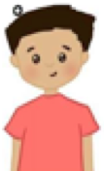
I think city anoles with bigger toe pads could climb higher, so they were healthier and had more offspring with bigger toe pads.
Agree or Disagree!
Notes:
ALL CLASS – SLIDE 5-7
One option: Call for student attention and point out that there are two signs at opposite ends of the classroom: Agree and Disagree. Explain that you are going to read out, one at a time, the three statements small groups have been discussing. Each time you read out one of the statements, students should move to the “agree” or “disagree” area of the classroom.
After students have moved to one position or the other (or raised hands), ask one or two student volunteers from the “disagree” side to explain why they disagreed and how their group decided to correct the statement. Follow up with a volunteer or two from the “agree” side. Finally, check with the whole class if they have consensus on the three statements.
Second option: Especially if you are pressed for time, have students stay in their small groups. Students should raise hands if they agree or disagree with each statement and a representative of each group can explain their justification. NB: This option might facilitate more reasoning out loud.
Please have students put their initials on the handout and staple/tape it into their notebook on page 15.

Slide 8
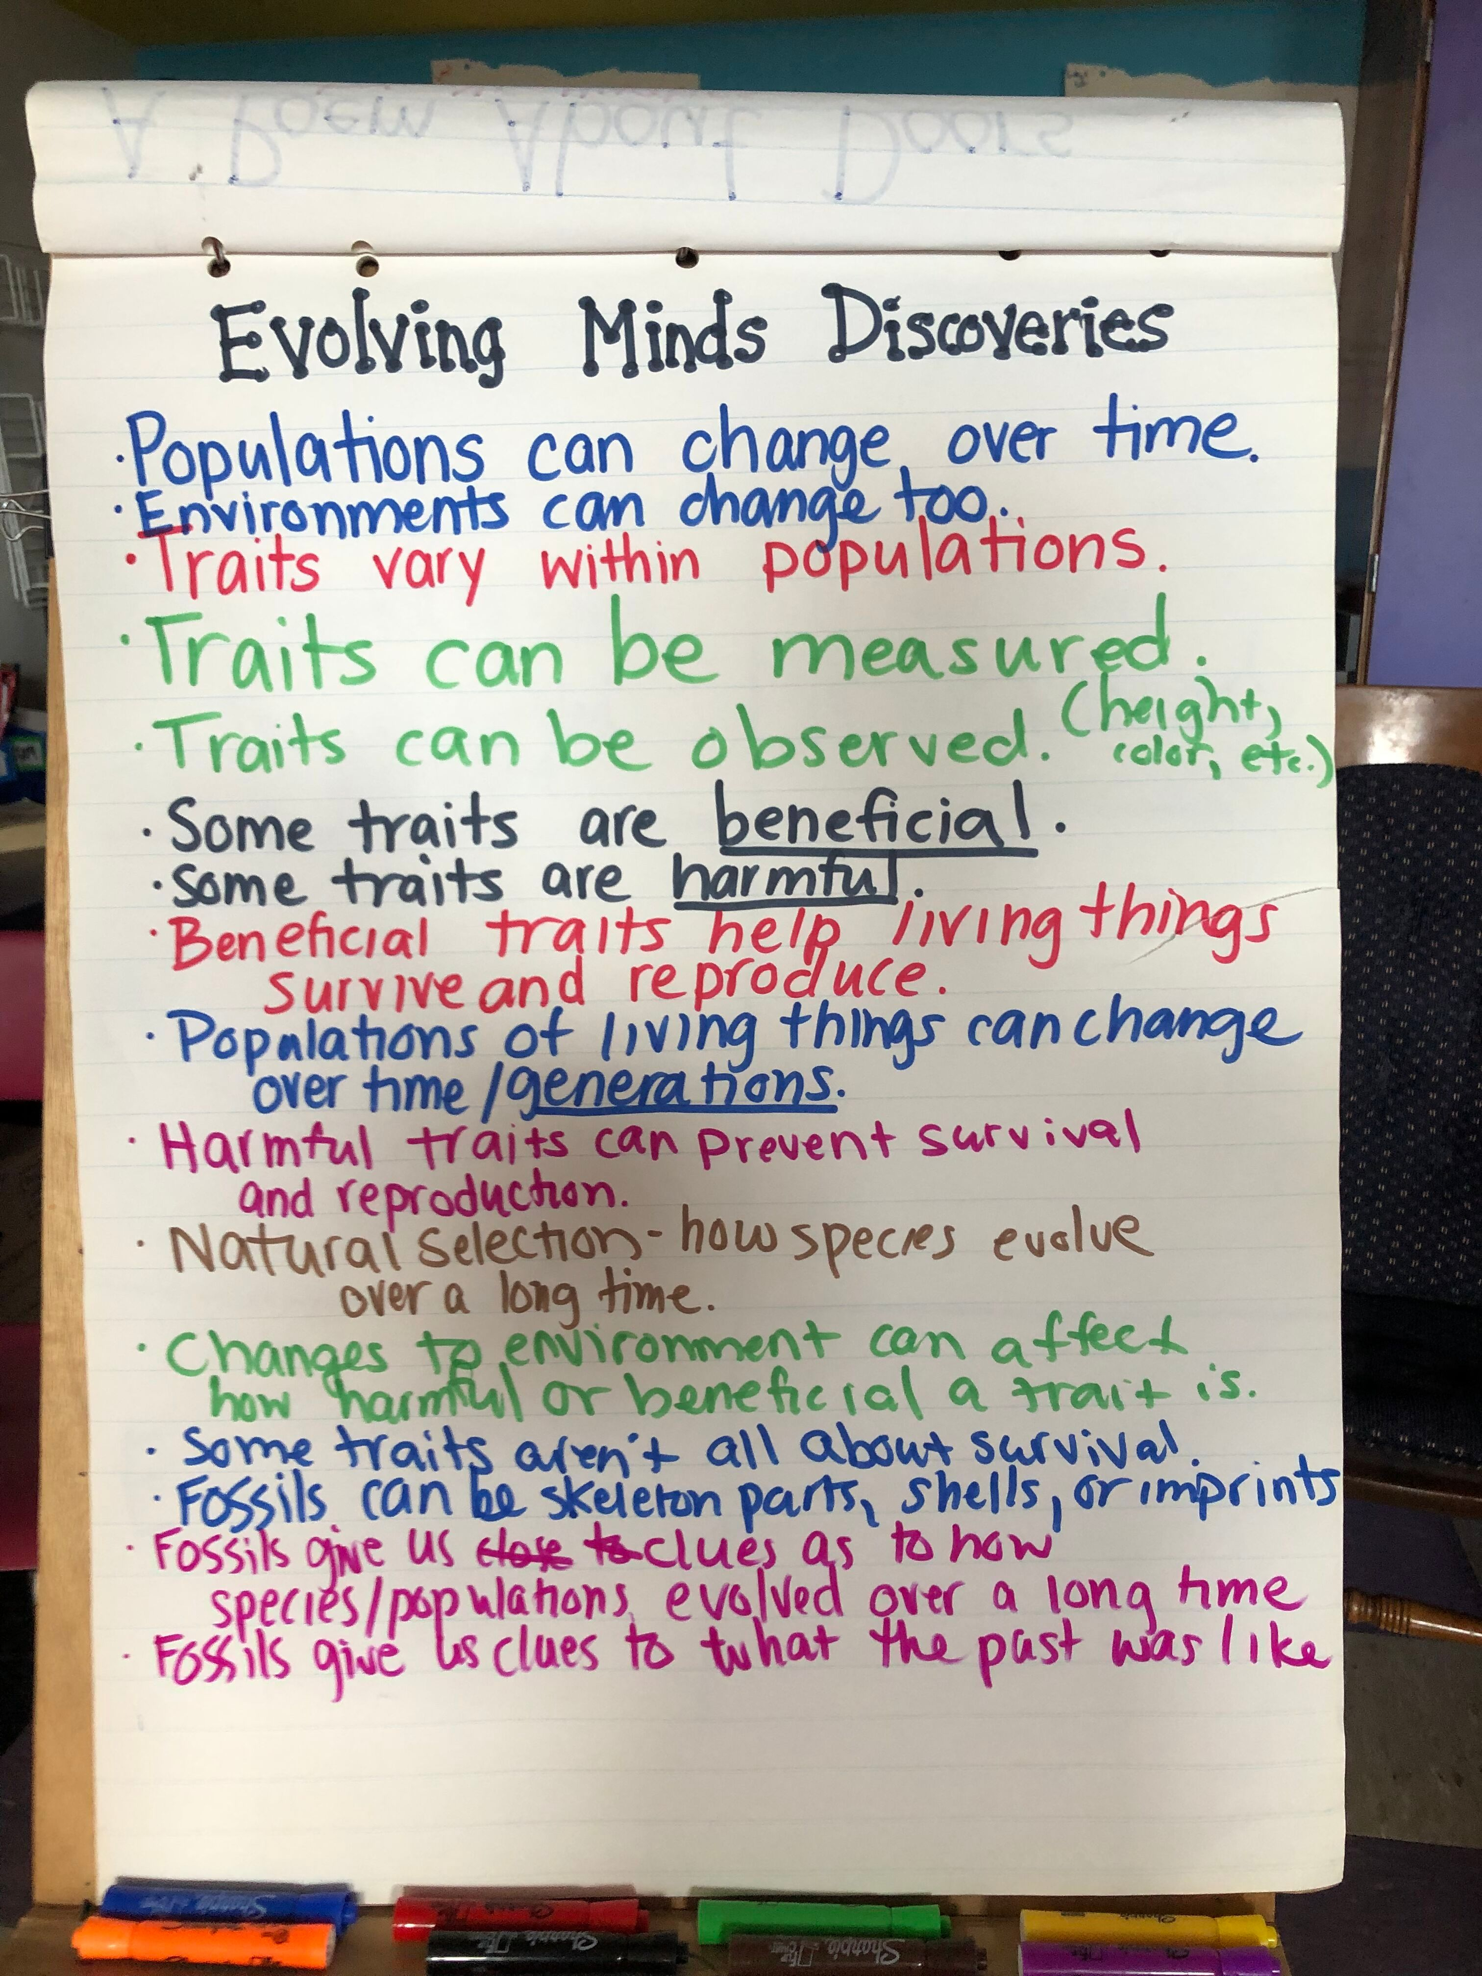
What ideas or information
are you taking away from today’s lesson?
What should we write on the Takeaways Chart?
Notes:
ALL CLASS – SLIDE 8
Ask students what ideas and information they will “take away” from today’s lesson to decide what they should record on the Takeaways Chart.
Listen for these ideas. Use student language as much as possible when you write them on the Takeaways Chart:
- The 6 Key Steps of natural selection can explain how a beneficial trait variant – larger toe pads with more lamellae – became more common in the anole city population over time.
- It is easy to describe the 6 Key Steps of natural selection incompletely.
Our question for next time is:
What evidence explains the evolution of new species over time?
[Save the 6 Key Steps chart you filled in today for future reference]

